Slide 1


Algorithm Visualizer
Presenting

Slide 2

Algorithm Visualizer
Welcome to this presentation exploring the fascinating world of sorting and searching algorithms. We'll visualize how these algorithms work their magic, revealing the secrets behind their efficiency and uncovering the elegant strategies they employ to solve complex problems. Get ready to embark on a journey of code and visuals, where the power of algorithms comes to life!
Presenting

Slide 3


Sorting and Searching Visualizer: A Deep Dive
Welcome to this presentation exploring the fascinating world of sorting and searching algorithms. We'll visualize how these algorithms work their magic, revealing the secrets behind their efficiency and uncovering the elegant strategies they employ to solve complex problems. Get ready to embark on a journey of code and visuals, where the power of algorithms comes to life!

Slide 4
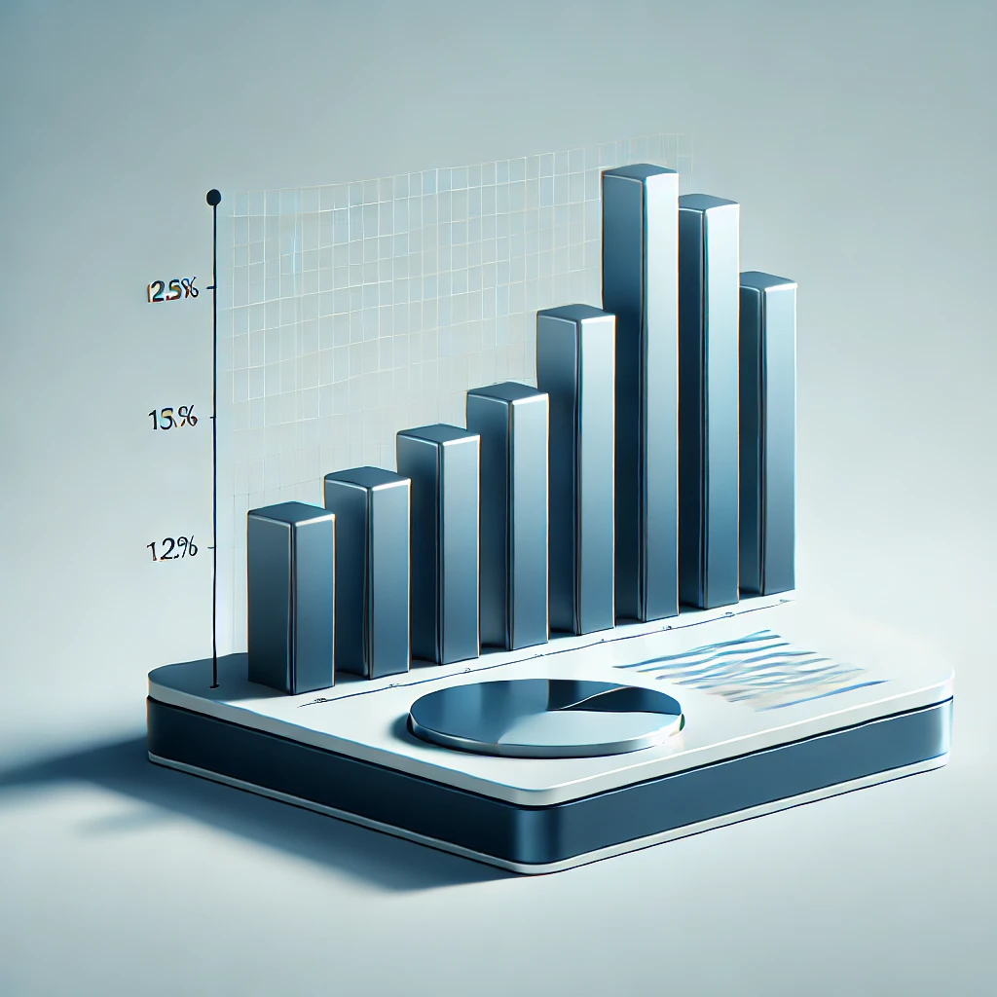
Sorting Algorithms
Bubble Sort: Repeatedly swaps adjacent elements (Best: O(n), Worst: O(n²)).
1
Selection Sort: Selects the smallest element and places it correctly (Best: O(n²), Worst: O(n²)).
2
Insertion Sort: Inserts elements into their correct position (Best: O(n), Worst: O(n²)).
3
Merge Sort: Divides and merges sorted parts (Best: O(n log n), Worst: O(n log n)).
4
Quick Sort: Uses a pivot to partition and sort efficiently (Best: O(n log n), Worst: O(n²)).
5

Slide 5
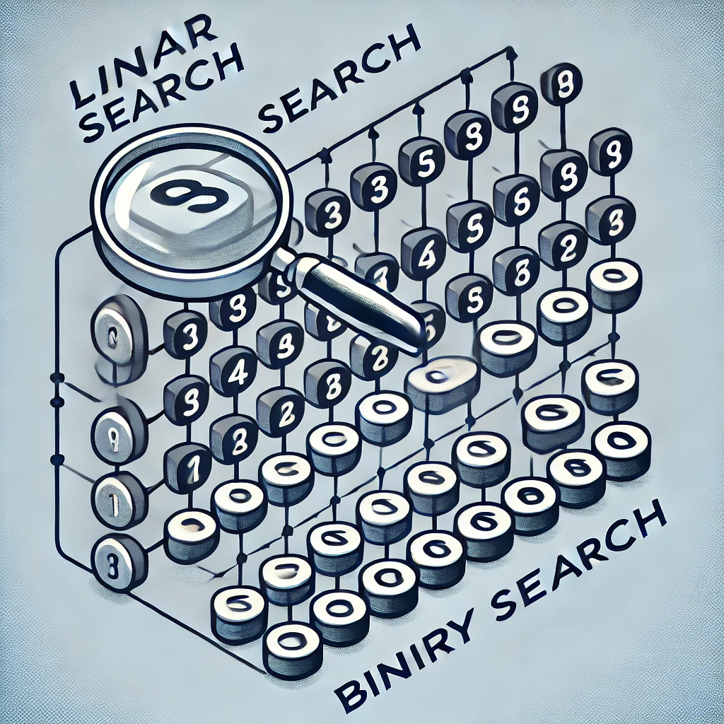
AI Insights: Suggest the best algorithm based on data.
More Algorithms: Add advanced algorithms like Dijkstra, A, DP, and Backtracking*.
Searching Algorithms
Linear Search: search for elements one by one (O(n)).
1.
Binary Search: Divides sorted data into halves (O(log n)).
2.
DataBase Integration of Users Visited and students Learned
E-Learning Integration: Embed into educational and coding platforms.

Slide 6

Future Scope
AI Insights: Suggest the best algorithm based on data.
More Algorithms: Add advanced algorithms like Dijkstra, A, DP, and Backtracking*.
E-Learning Integration: Embed into educational and coding platforms.
DataBase Integration of Users Visited and students Learned

Slide 7
Thank You..

